Slide 1




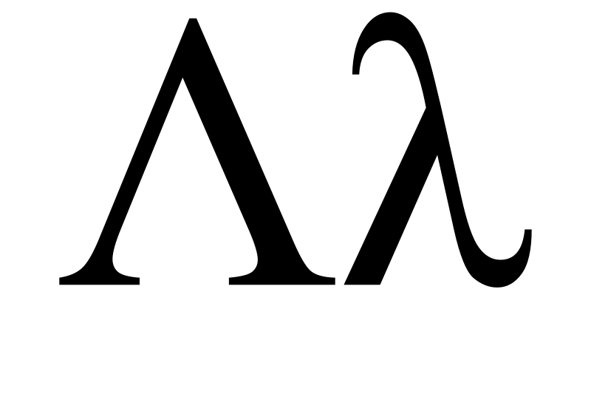
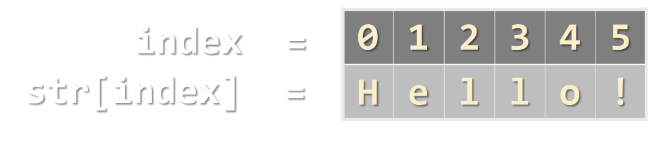
Strings, Dictionaries, Lambda and LINQ
Text Processing, Dictionaries, Lambda Functions, LINQ
Magic?
SoftUni Team
Technical Trainers
Software University
http://softuni.bg

Slide 2

Table of Contents
Strings and Text Processing
Formatting and Format Strings
Basic String Operations: Concatenation, Searching, Substring, Replace, Remove
Dictionaries and Dictionary<K, V>
Mapping Keys to Values
Data Processing with Lambda and LINQ
Filtering, Mapping, Ordering

Slide 3
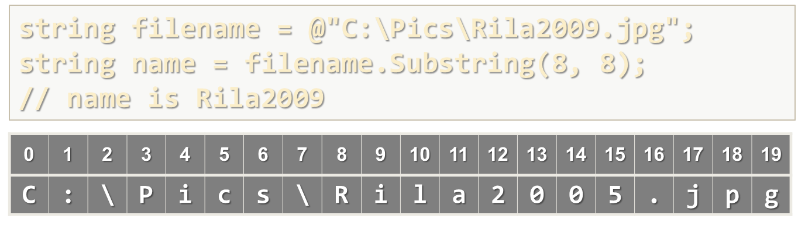


Strings and Text Processing
Basic String Operations

Slide 4
What Is String?
Strings are sequences of Unicode characters
Like array of characters: supports Length and access by index []
Immutable by design: cannot be modified!
Represented by the string data type in C# (System.String)
Example:
string s = "Hello!";
int len = s.Length; // len = 6 char ch = s[1]; // ch = 'e'
index =
0 | 1 | 2 | 3 | 4 | 5
H | e | l | l | o | !
str[index] =

Slide 5
Problem: Print String Letters
Read a string and print its letters as in the examples below:
SoftUni
string str = Console.ReadLine();
for (int i = 0; i < str.Length; i++)
{
char ch = str[i];
Console.WriteLine(
"str[{0}] -> '{1}'", i, ch);
}
str[0] -> 'S'
str[1] -> 'o'
str[2] -> 'f'
str[3] -> 't'
str[4] -> 'U'
str[5] -> 'n'
str[6] -> 'i'
Check your solution here: https://judge.softuni.bg/Contests/Practice/Index/174#0

Slide 6
Problem: Count Letters in String (Histogram)
Read a string and count how many times each character occurs
Print all chars (case insensitive) alphabetically with their counts
Alabala
ooooo, kef
C# Basics
a -> 4
b -> 1
l -> 2
-> 1
, -> 1
e -> 1
f -> 1
k -> 1
o -> 5
-> 1
# -> 1
a -> 1
b -> 1
c -> 2
i -> 1
s -> 2
Check your solution here: https://judge.softuni.bg/Contests/Practice/Index/174#1

Slide 7
Solution: Count Letters in String
string str = Console.ReadLine().ToLower();
// Count the character occurences
int[] count = new int[str.Max() + 1];
foreach (char ch in str)
count[ch]++;
// Print the non-zero counts
for (char ch = (char)0; ch < count.Length; ch++)
if (count[ch] != 0)
Console.WriteLine($"{ch} -> {count[ch]}");
Check your solution here: https://judge.softuni.bg/Contests/Practice/Index/174#1

Slide 8
ToString() and String.Format(…)
In C# all data types can be converted to strings:
String.Format() processes string-formatting expressions
Interpolated strings work in similar way:
int num = 5;
string s = "num = " + num.ToString(); // num = 5
int num = 5;
string s = string.Format("num = {0}", num); // num = 5
int num = 5;
string s = $"num = {num}"; // num = 5

Slide 9
Data Formatting and Format Strings
A format string specifies how to convert a value to string
int number = 42;
Console.WriteLine(number.ToString("D5")); // 00042
Console.WriteLine(number.ToString("X")); // 2A
// Consider the default culture is U.S.
Console.WriteLine(number.ToString("C")); // $42.00
double d = 0.375;
Console.WriteLine(d.ToString("P2")); // 37.50 %
Console.WriteLine(d.ToString("F2")); // 0.38
Console.WriteLine("Now is {0:d.MM.yyyy HH:mm:ss}",
DateTime.Now); // Now is 31.11.2009 11:30:32

Slide 10
Cultures and Regional Settings
Culture (locale / region / language) specifies formatting settings
Decimal separator ("." or ","), currency symbol, date format, …
If not specified, the current culture is taken from the OS
var number = 1.5;
Thread.CurrentThread.CurrentCulture = new CultureInfo("en-US");
Console.WriteLine(number.ToString("C")); // $1.50
Thread.CurrentThread.CurrentCulture = CultureInfo.InvariantCulture;
Console.WriteLine(number.ToString("C")); // ¤1.50
Thread.CurrentThread.CurrentCulture = new CultureInfo("bg-BG");
Console.WriteLine(number.ToString("C")); // 1,50 лв.

Slide 11


Format Strings
Some format strings for numbers:
D – number (for integer types)
F – fixed point (for real numbers)
X – hexadecimal number
C – currency (according to current culture)
P – percentage
Format strings for date and time formatting:
d, dd, M, MM, yy, yyyy, h, hh, H, HH, m, mm, s, ss, t

Slide 12
Composite Formatting
Composite formatting uses the following format:
Composite formatting is used in string.Format() and Console.WriteLine():
{index[,alignment][:formatString]}
double d = 0.375;
s = String.Format("{0,10:F5}", d); // s = " 0,37500"
int num = 42;
Console.WriteLine("Dec {0:D} = Hex {1:X}", num, num);
// Dec 42 = Hex 2A

Slide 13
Problem: Print a Receipt
Read a sequence of numbers and print a receipt of width 24 chars:
12.5 7 0.50234
460 000230 450.6666666
/----------------------\
| 12.50 |
| 7.00 |
| 0.50 |
|----------------------|
| Total: 20.00 |
\----------------------/
/----------------------\
| 460.00 |
| 230.00 |
| 450.67 |
|----------------------|
| Total: 1140.67 |
\----------------------/
Check your solution here: https://judge.softuni.bg/Contests/Practice/Index/174#2

Slide 14
Solution: Print a Receipt
var nums = Console.ReadLine().
Split(' ').Select(decimal.Parse);
Console.WriteLine(@"/----------------------\");
foreach (var num in nums)
Console.WriteLine("| {0,20:f2} |", num);
Console.WriteLine(@"|----------------------|");
// TODO: print the "Total" line…
Console.WriteLine(@"\----------------------/");
Check your solution here: https://judge.softuni.bg/Contests/Practice/Index/174#2

Slide 15

Searching in Strings: IndexOf() / LastIndexOf()
string str = "C# Programming Course";
int index = str.IndexOf("C#"); // index = 0
index = str.IndexOf("Course"); // index = 15
index = str.IndexOf("COURSE"); // index = -1
// IndexOf is case-sensetive. -1 means "Not found"
index = str.IndexOf("ram"); // index = 7
index = str.IndexOf("r"); // index = 4
index = str.IndexOf("r", 5); // index = 7
index = str.LastIndexOf("r"); // index = 18
index =
0 | 1 | 2 | 3 | 4 | 5 | 6 | 7 | 8 | 9 | 10 | 11 | 12 | 13 | …
C | # |  | P | r | o | g | r | a | m | m | i | n | g | …
str[index] =

Slide 16
Problem: Count Occurrences in String
Read a text and a substr and count how many times substr occurs in the text as a substring (case-insensitive)
Hint: use text.IndexOf(substr, offset) in a loop
Use as offset the last occurrence index + 1
Alabala
la
aaaabaaa
aa
huhuhui
huhhu
Hello, hello
he
2
5
0
2
Check your solution here: https://judge.softuni.bg/Contests/Practice/Index/174#3

Slide 17
Solution: Count Occurrences in String
string text = Console.ReadLine().ToLower();
string word = Console.ReadLine().ToLower();
int count = 0, offset = -1;
while (true)
{
offset = text.IndexOf(word, offset + 1);
if (offset == -1) break; // No more occurrences
count++;
}
Console.WriteLine($"Occurrences: {count}");
Check your solution here: https://judge.softuni.bg/Contests/Practice/Index/174#3

Slide 18
Compare, Substring, Replace, Remove, Insert
int result = string.Compare("Sofia", "Varna"); // -1 (Before)
result = string.Compare("Sofia", "SOFIA", true); // 0 (Equal)
result = string.Compare("Sofia", "Bourgas"); // 1 (After)
string filename = @"C:\Pics\Rila2016.jpg";
string name = filename.Substring(8, 8); // Rila2016
string fname = filename.Substring(8); // Rila2016.jpg
string cocktail = "vodka + tomato juice + hot sauce";
string replaced = cocktail.Replace("+", "and");
// vodka and tomato juice and hot sauce
string price = "$1234567";
string lowPrice = price.Remove(2, 4); // $167
string finalPrice = price.Insert(3, "55"); // $16557

Slide 19
Problem: Change Forbidden Substrings
Read a text and several forbidden words
Replace all forbidden words with stars (e.g. beer → ****)
Use "substring" matching (match part of word), case-sensitive:
Learn how to earn money or read the HOWto e-learning.
beer how programming PHP MySQL earn bitcoins
L**** *** to **** money or read the HOWto e-l****ing
Check your solution here: https://judge.softuni.bg/Contests/Practice/Index/174#4

Slide 20
Solution: Change Forbidden Substrings
string text = Console.ReadLine();
string[] words = Console.ReadLine().Split(' ');
foreach (var w in words)
text = text.Replace(w,
new string('*', w.Length));
Console.WriteLine(text);
Check your solution here: https://judge.softuni.bg/Contests/Practice/Index/174#4

Slide 21


Working with Strings
Live Exercises in Class (Lab)

Slide 22


Dictionaries
key
value
John Smith | +1-555-8976
Nakov | +359-2-981-9819
Sam Doe | +1-555-5030
Using Dictionary<K, V>

Slide 23
Associative Arrays (Maps, Dictionaries)
Associative arrays (dictionaries) are arrays indexed by keys
Not by the numbers 0, 1, 2, …
Hold a set of pairs {key → value}
Traditional array
Associative array (dictionary)
key
value
key
0 1 2 3 4
John Smith | +1-555-8976
Lisa Smith | +1-555-1234
Sam Doe | +1-555-5030
value
8 | -3 | 12 | 408 | 33

Slide 24
Phonebook – Dictionary Example
var phonebook = new Dictionary<string, string>();
phonebook["John Smith"] = "+1-555-8976"; phonebook["Lisa Smith"] = "+1-555-1234";
phonebook["Sam Doe"] = "+1-555-5030";
phonebook["Nakov"] = "+359-899-555-592";
phonebook["Nakov"] = "+359-2-981-9819";
phonebook.Remove("John Smith");
foreach (var pair in phonebook)
Console.WriteLine("{0} --> {1}",
pair.Key, pair.Value);

Slide 25
Events – SortedDictionary Example
var events = new SortedDictionary<DateTime, string>();
events[new DateTime(1998, 9, 4)] = "Google's birth date";
events[new DateTime(2013, 11, 5)] = "SoftUni's birth date";
events[new DateTime(1975, 4, 4)] = "Microsoft's birth date";
events[new DateTime(2004, 2, 4)] = "Facebook's birth date";
events[new DateTime(2013, 11, 5)] = "SoftUni was founded";
foreach (var entry in events)
{
Console.WriteLine("{0:dd-MMM-yyyy}: {1}",
entry.Key, entry.Value);
}

Slide 26
Problem: Count Real Numbers
Read a list of real numbers and print them in ascending order along with their number of occurrences
8 2.5 2.5 8 2.5
1.5 5 1.5 3
-2 0.33 0.33 2
2.5 -> 3 times
8 -> 2 times
1.5 -> 2 times
3 -> 1 times
5 -> 1 times
-2 -> 1 times
0.33 -> 2 times
2 -> 1 times
Check your solution here: https://judge.softuni.bg/Contests/Practice/Index/173#5

Slide 27
Solution: Count Real Numbers
var nums = Console.ReadLine().Split(' ')
.Select(double.Parse).ToList();
var counts = new SortedDictionary<double, int>();
foreach (var num in nums)
if (counts.ContainsKey(num))
counts[num]++;
else
counts[num] = 1;
foreach (var num in counts.Keys)
Console.WriteLine($"{num} -> {counts[num]}");
counts[num] holds how many times num occurs in nums
Check your solution here: https://judge.softuni.bg/Contests/Practice/Index/173#5

Slide 28
Problem: Odd Occurrences
Write a program to extract from given sequence of words all elements that present in it odd number of times (case-insensitive)
Words are given in a single line, space separated
Print the result elements in lowercase, in their order of appearance
Java C# PHP PHP JAVA C java
java, c#, c
3 5 5 hi pi HO Hi 5 ho 3 hi pi
5, hi
a a A SQL xx a xx a A a XX c
a, SQL, xx, c
Check your solution here: https://judge.softuni.bg/Contests/Practice/Index/173#6

Slide 29
Solution: Odd Occurrences
var words = Console.ReadLine().ToLower().Split(' ');
var counts = new Dictionary<string, int>();
foreach (var w in words)
if (counts.ContainsKey(w))
counts[w]++;
else counts[w] = 1;
var results = new List<string>();
foreach (var pair in counts)
// TODO: add pair.Key to results if pair.Value is odd
Console.WriteLine(string.Join(", ", results));
counts[w] holds how many times w occurs in words
Check your solution here: https://judge.softuni.bg/Contests/Practice/Index/173#6

Slide 30
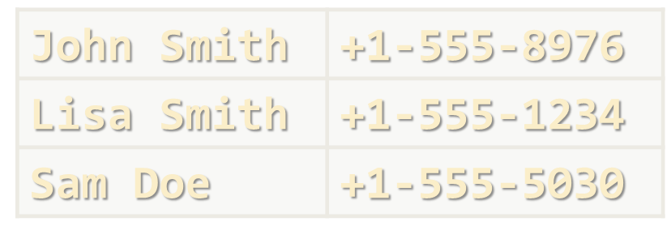
Working with Dictionaries
Live Exercises in Class (Lab)

Slide 31

Lambda Functions and LINQ
var count = "some text"
.Where(c => !char.IsLetter(c))
.Count();
Objects
LINQ
Data
Search
LINQ in Action: Filtering, Mapping, Ordering

Slide 32
Processing Sequences of Elements
Extension methods attach functionality to existing types
The LINQ extension methods add sequence processing
Add "using System.Linq;" at the start of your C# file
using System.Linq;
…
int[] arr = { 10, 30, 50, 20, 40 };
Console.WriteLine(arr.Sum()); // 150
Console.WriteLine(arr.Max()); // 50
Console.WriteLine(arr.Last()); // 40
Console.WriteLine(arr.Skip(3).First()); // 20
Console.WriteLine(arr.Skip(1).Take(3).Min()); // 20

Slide 33
Problem: Largest 3 Numbers
Read a list of real numbers and print largest 3 of them
Sample solution with LINQ:
10 30 15 20 50 5
50 30 20
20 30
30 20
string[] strings = Console.ReadLine().Split(' ');
List<int> nums = strings.Select(int.Parse).ToList();
var sortedNums = nums.OrderBy(x => -x);
var largest3Nums = sortedNums.Take(3);
Console.WriteLine(string.Join(" ", largest3Nums));
Check your solution here: https://judge.softuni.bg/Contests/Practice/Index/173#7

Slide 34
Lambda Expressions / Lambda Functions
Lambda functions are inline methods (functions) that take input parameters and return values:
Passed to higher order functions like Where(func):
x => x / 2
static int Func(int x) { return x / 2; }
x => x != 0
static bool Func(int x) { return x != 0; }
() => 42
static int Func() { return 42; }
var nums = new int[]{ 5, 6, 7, 3}.Where(x => x > 5);
Console.WriteLine(string.Join(", ", nums)); // 6, 7

Slide 35
Filtering and Sorting with Lambda Functions
int[] nums = { 11, 99, 33, 55, 77, 44, 66, 22, 88 };
var smallNums = nums.Where(x => x < 50);
Console.WriteLine("Nums < 50: " +
string.Join(" ", smallNums)); // 11 33 44 22
Console.WriteLine("Odd numbers count: " + nums. Where(x => x % 2 == 1).Count()); // 5 {11, 99, 33, 55, 77}
Console.WriteLine("Odd positions: " + string.Join(" ",
nums.Where((x, pos) => pos % 2 == 1))); // 99 55 44 22
Console.WriteLine("Smallest 3 nums: " + string.Join(" ",
nums.OrderBy(x => x).Take(3))); // 11 22 33
Console.WriteLine("First 5 nums * 2: " + string.Join(" ",
nums.Select(x => x * 2).Take(5))); // 22 198 66 110 154

Slide 36
Problem: Short Words Sorted
Read a text, extract its words, find all short words (less than 5 characters) and print them alphabetically, in lower case
Use the following separators: . , : ; ( ) [ ] " ' / \ ! ? (space)
Use case-insensitive matching; remove duplicated words
In SoftUni you can study Java, C#, PHP and JavaScript. JAVA and c# developers graduate in 2-3 years. Go in!
2-3, and, c#, can, go, in, java, php, you
Check your solution here: https://judge.softuni.bg/Contests/Practice/Index/173#8

Slide 37
Solution: Short Words Sorted
char[] separators = ".,:;()[]\"'\\/!? ".ToCharArray();
var words = Console.ReadLine().ToLower()
.Split(separators);
var result = words
.Where(w => w != "")
// TODO: filter by word length < 5
.OrderBy(w => w)
.Distinct();
Console.WriteLine(string.Join(", ", result));
Check your solution here: https://judge.softuni.bg/Contests/Practice/Index/173#8

Slide 38
Problem: Fold and Sum
Read an array of 4*k integers, fold it like shown below, and print the sum of the upper and lower rows (2*k integers):
1 2
3 4 5 6
7 8
5 2 3 6
5 6
2 3
7 9
1 2
7 8
1 2 3 4 5 6 7 8
2 1 8 7
3 4 5 6
5 5 13 13
3 4 5 6
4 3 -1 2 5 0 1 9 8 6 7 -2
-1 3 4 -2 7 6
2 5 0 1 9 8
1 8 4 -1 16 14
Check your solution here: https://judge.softuni.bg/Contests/Practice/Index/173#9

Slide 39
Solution: Fold and Sum
int[] arr = Console.ReadLine()
.Split(' ').Select(int.Parse).ToArray();
int k = arr.Length / 4;
var row1left = arr.Take(k).Reverse();
var row1right = arr.Reverse().Take(k);
int[] row1 = row1left.Concat(row1right).ToArray();
int[] row2 = arr.Skip(k).Take(2 * k).ToArray();
var sumArr =
row1.Select((x, index) => x + row2[index]);
Console.WriteLine(string.Join(" ", sumArr));
Check your solution here: https://judge.softuni.bg/Contests/Practice/Index/173#9

Slide 40

Lambda Expressions and LINQ
LINQ
var count = arr
.Where(e => e % 2 == 0)
.Count();
Live Exercises in Class (Lab)

Slide 41

Summary
Strings provide text-processing functionality
Formatting data by pattern, concatenation, search, substring, insert, remove, replace, …
Dictionaries hold {key → value} pairs
Lambda and LINQ dramatically simplifies collection processing:
var grades = new Dictionary<string, double>();
grades["Maria"] = 5.50;
int[] nums = { 11, 99, 3, 55, 7, 4, 66, 2, 88 };
var smallNums = nums.Where(x => x < 50).Count();

Slide 42








Strings, Dictionaries, Lambda and LINQ
https://softuni.bg/courses/programming-fundamentals

Slide 43
License
This course (slides, examples, demos, videos, homework, etc.) is licensed under the "Creative Commons Attribution-NonCommercial-ShareAlike 4.0 International" license
Attribution: this work may contain portions from
"Fundamentals of Computer Programming with C#" book by Svetlin Nakov & Co. under CC-BY-SA license

Slide 44






Free Trainings @ Software University
Software University Foundation – softuni.org
Software University – High-Quality Education, Profession and Job for Software Developers
softuni.bg
Software University @ Facebook
facebook.com/SoftwareUniversity
Software University @ YouTube
youtube.com/SoftwareUniversity
Software University Forums – forum.softuni.bg

